Slide 1
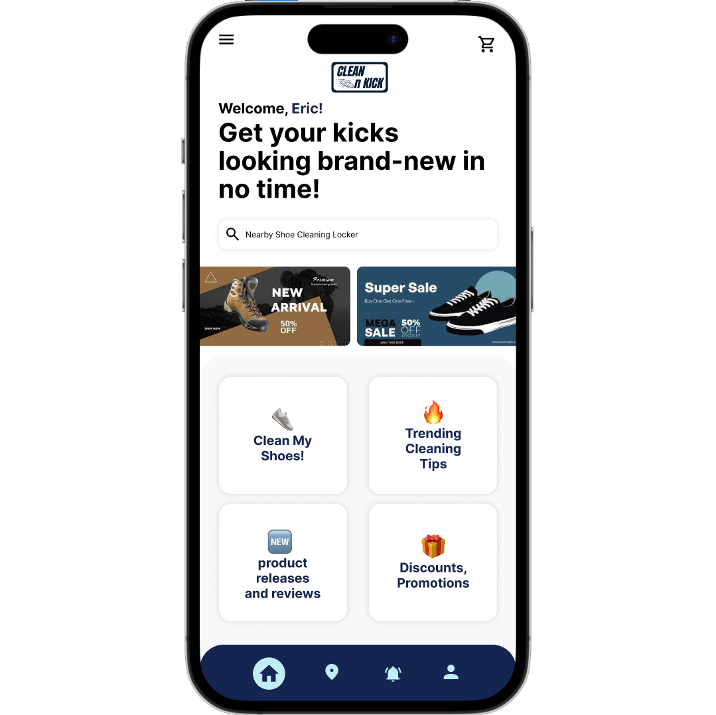
CLEAN N KICK
WE CHANGE THE WAY
NEW YORKERS CLEAN THEIR SHOES
CONTACT :
Eric Salim Marlie eriicsalim@yahoo.com | 917-684-2578
1

Slide 2


55%
CLEAN SHOES IS IMPORTANT
72%
OCCASIONALLY, RARELY, OR NEVER CLEAN THEIR SHOES.
2

Slide 3
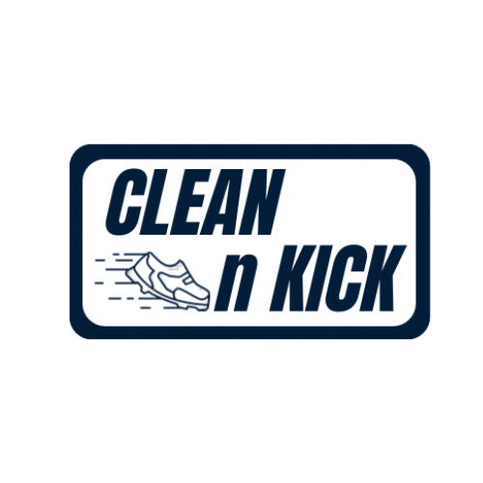




THE PROBLEM
Sneaker cleaning is costly, inconvenient, and time consuming
9%
28%
37%
55%
DON'T KNOW HOW TO PROPERLY CLEAN THEM
EXPENSIVE
DON'T HAVE TIME
72%
Of surveyed students consider CLEAN SHOES IS IMPORTANT
Of them OCCASIONALLY, RARELY, OR NEVER CLEAN THEIR SHOES.
*100 BMCC Survey respondents, April 2023
3

Slide 4



THE SOLUTION
CLEAN N KICK simplifies shoe care for busy New Yorkers with our
smart locker system, conveniently located in places like college campuses.
Our innovative solution allows customers to :
Save Time and Money
Increase Shoes Lifespan
Maintain Shoes Hygiene
4

Slide 5
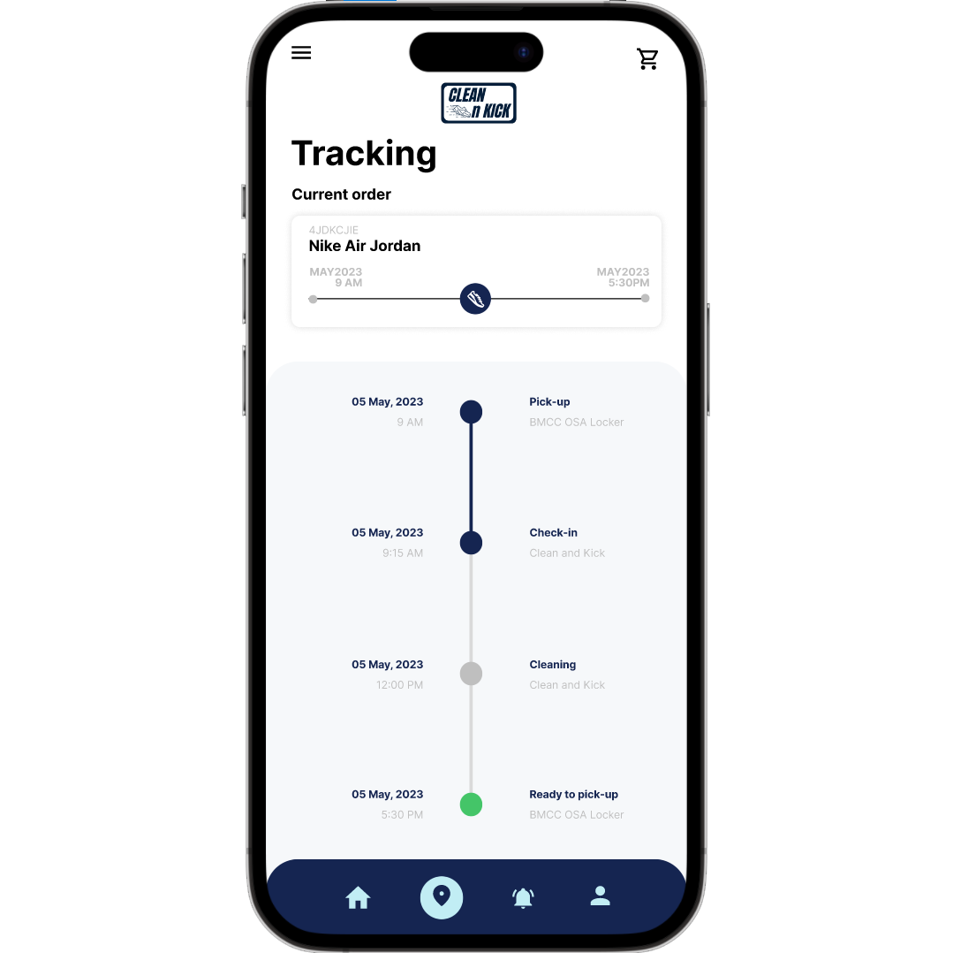
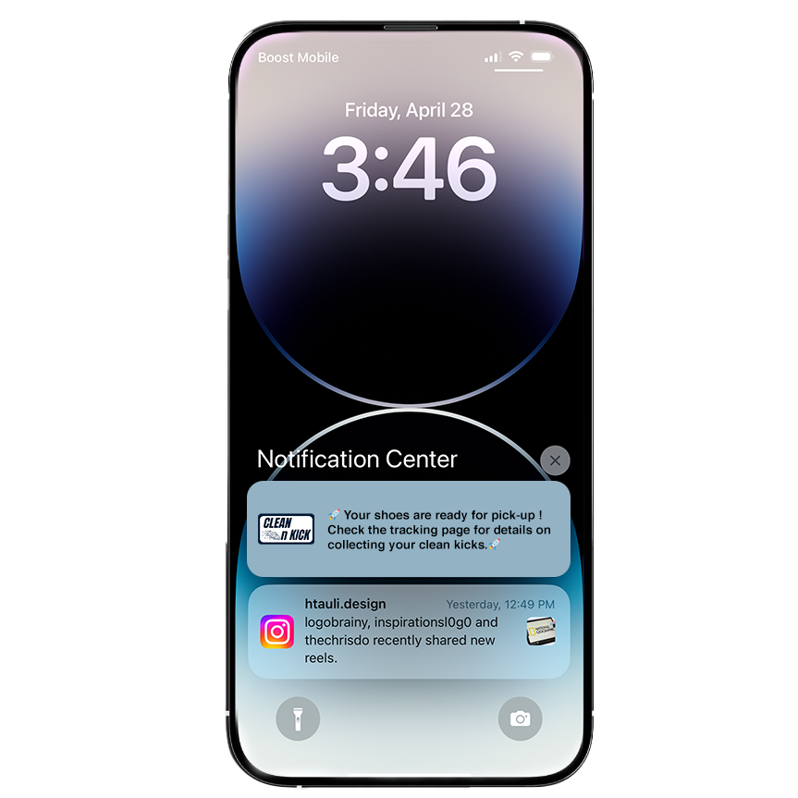
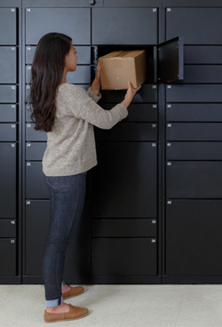



CUSTOMER JOURNEY
HOW IT WORKS
Source : Appleinsider
1. CHECKOUT
2. DROP OFF
3. LEAVE IT
4. PICK IT UP
5

Slide 6
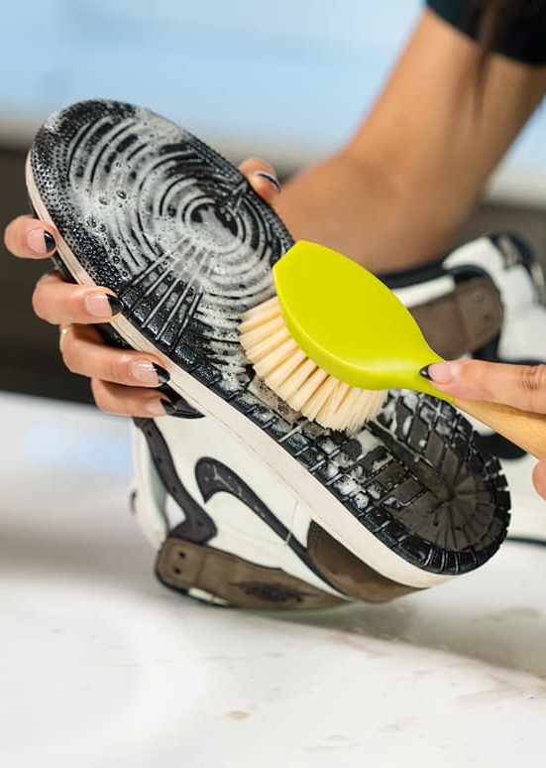
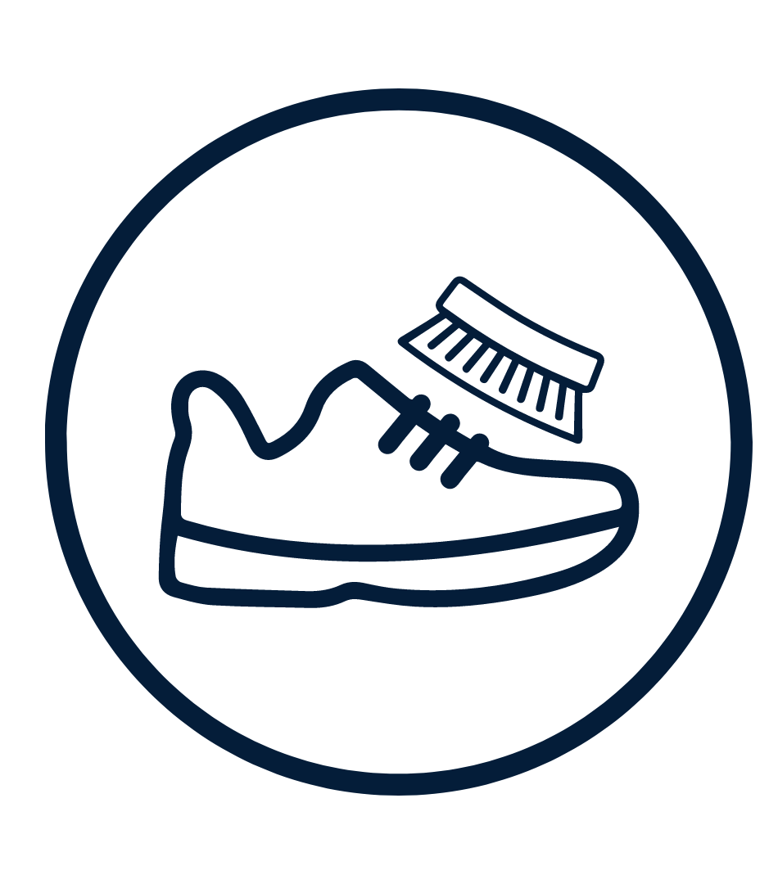
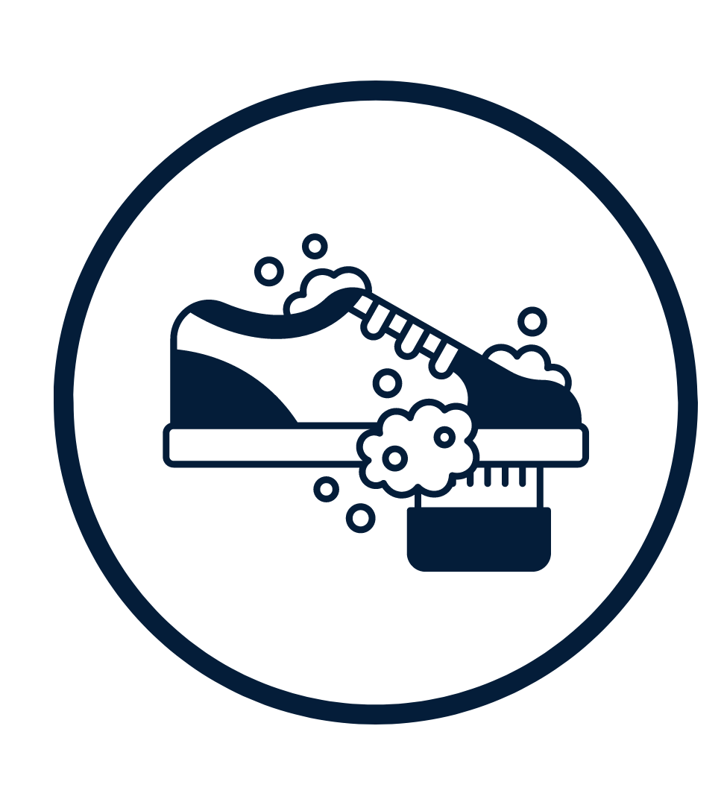



DAY-TO-DAY OPERATION
REGULAR CLEAN
Thorough exterior cleaning PRICE : $15
PREMIUM CLEAN
Complete interior and exterior cleaning PRICE : $25
REVENUE AND BUSINESS MODEL
FUTURE PLAN
DIVERSIFICATION
FRANCHISE SALES
SUBSCRIPTION MODEL
FRANCHISE FEE
SHOE SHINING
$30,000
SNEAKER RESTORATION
SHOE ACCESSORIES
ROYALTY FEE
80%/20% for five years
CLEANING PRODUCTS
7

Slide 7









TARGET MARKET IN NYC
Available Market:
594,000+ University Students in NYC
Potential Market:
1.6m+ office workers in NYC
Target Market:
19,000+ College students at BMCC
ON AVERAGE NEW YORKERS OWN
$4.9 BILLION
8 SHOES + 2/yr
GLOBAL SHOE CARE MARKET IN 2020
Source : ARCH-USA
Source : Grand View Research
6

Slide 8



THE TEAM
Eric Salim Marlie
Htet Aung Lin
Shani Majer
Founder & CEO
UI/UX & App Development
Strategic Partner
Three years experience growing an online basketball store in Indonesia, currently studying digital marketing at BMCC.
Over three years of experience in graphic design, currently pursuing a digital imaging degree at BMCC.
CPA with extensive experience in finance, startups, and venture capital.
10

Slide 9


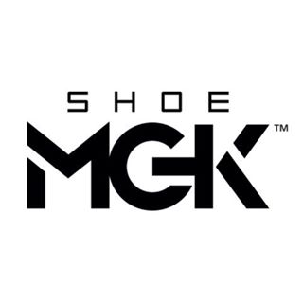



COMPETITION
Our Unique Perspective on the Market
CONVENIENT
CONVENIENT DROPOFF AND PICKUP SERVICES
COMPETITIVE PRICING
SIMPLE AND SEAMLESS PROCESS
OFFLINE
ONLINE
MORE THAN 400
Shoe cleaning stores across NYC
*AVERAGE PRICE $30
*AVERAGE PRICE $50
LESS CONVENIENT
11

Slide 10
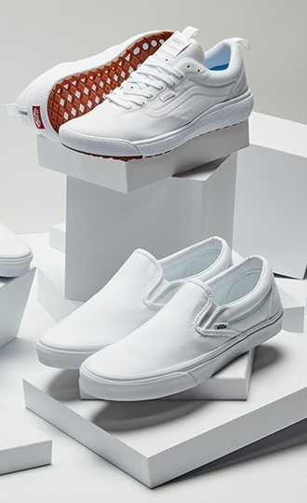





JOIN US IN REVOLUTIONIZING THE WAY NEW YORKERS CLEAN THEIR SHOES
CONTACT :
Eric Salim Marlie eriicsalim@yahoo.com 917-684-2578 linkedin.com/in/ericsalimm
Quick Access Contact
12

